Slide 1
Credit Analytics – Credit Default Modelling and predicting PD, loss given defaults (LGD) and exposure at defaults (EAD)

Slide 2
Factors affecting Credit Risk Modeling
Factors affecting credit risk modeling that lenders should consider:
Probability of Default (POD) - the likelihood that a borrower will default on their loan obligations
Loss Given Default (LGD) - the amount of money a bank or other financial institution loses when a borrower defaults on a loan, depicted as a percentage of total exposure at the time of default
Exposure at Default (EAD) - evaluates the amount of loss exposure that a lender is exposed to at any particular time, and it is an indicator of the risk appetite of the lender
Notes:
Notes:
1. Probability of Default (POD)
The probability of default, sometimes abbreviated as POD, is the likelihood that a borrower will default on their loan obligations. For individual borrowers, POD is based on a combination of two factors, i.e., credit score and debt-to-income ratio.
The POD for corporate borrowers is obtained from credit rating agencies. If the lender determines that a potential borrower demonstrates a lower probability of default, the loan will come with a low interest rate and low or no down payment on the loan. The risk is partly managed by pledging collateral against the loan.
2. Loss Given Default (LGD)
Loss given default (LGD) refers to the amount of loss that a lender will suffer in case a borrower defaults on the loan. For example, assume that two borrowers, A and B, with the same debt-to-income ratio and an identical credit score. Borrower A takes a loan of $10,000 while B takes a loan of $200,000.
The two borrowers present with different credit profiles, and the lender stands to suffer a greater loss when Borrower B defaults since the latter owes a larger amount. Although there is no standard practice of calculating LGD, lenders consider an entire portfolio of loans to determine the total exposure to loss.
3. Exposure at Default (EAD)
Exposure at Default (EAD) evaluates the amount of loss exposure that a lender is exposed to at any particular time, and it is an indicator of the risk appetite of the lender. EAD is an important concept that references both individual and corporate borrowers. It is calculated by multiplying each loan obligation by a specific percentage that is adjusted based on the particulars of the loan.

Slide 3
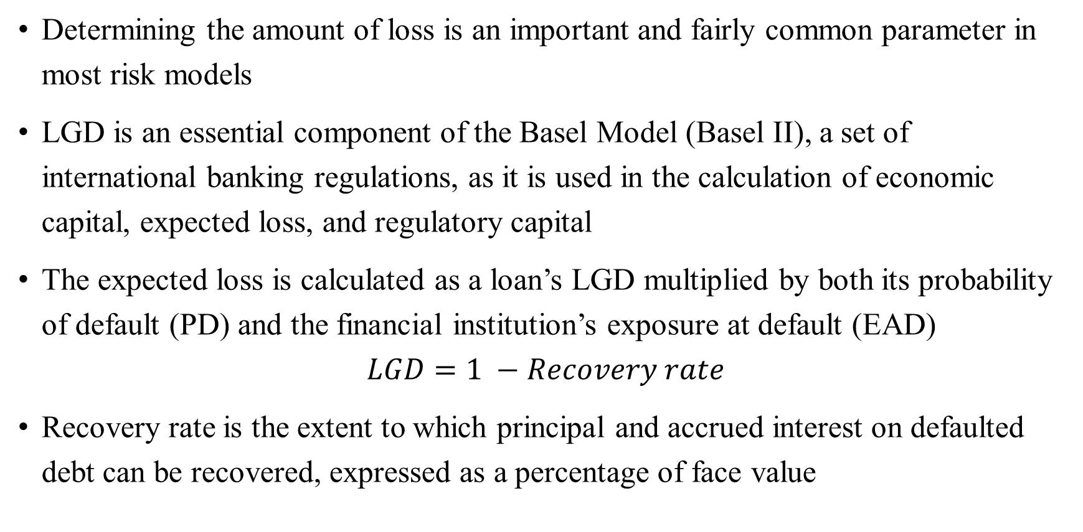
Why is LGD Important?
Determining the amount of loss is an important and fairly common parameter in most risk models
LGD is an essential component of the Basel Model (Basel II), a set of international banking regulations, as it is used in the calculation of economic capital, expected loss, and regulatory capital
The expected loss is calculated as a loan’s LGD multiplied by both its probability of default (PD) and the financial institution’s exposure at default (EAD)
$$LGD=1 −Recovery rate$$
Recovery rate is the extent to which principal and accrued interest on defaulted debt can be recovered, expressed as a percentage of face value
Notes:
Notes:
A financial institution’s total LGD is calculated after a review of all outstanding loans using cumulative losses and exposure. The loss given default (LGD) is an important calculation for financial institutions projecting out their expected losses due to borrowers defaulting on loans.
The recovery rate enables an estimate to be made of the loss that would arise in the event of default, which is calculated as (1 - Recovery Rate). Thus, if the recovery rate is 60%, the loss given default or LGD is 40%. On a $10 million debt instrument, the estimated loss arising from default is thus $4 million.

Slide 4
Why is EAD Important?
In response to the Global Financial Crisis of 2007-2008, the banking sector adopted international regulations to lessen its exposure to default
EAD (Exposure at Default) and LGD (Loss Given Default) estimates are key inputs in the measurement of the expected and unexpected credit losses and, hence, credit risk capital (regulatory and economic)
The regulatory framework (Basel III) put forth by the Basel Committee on Bank Supervision (BCBS) following the financial crisis aims to improve the banking sector’s ability to deal with shocks arising from financial and economic stress
By improving risk management, disclosure standards, and bank transparency, the international accord hopes to avoid a domino effect of failing financial institutions
Notes:
Notes:
Exposure at default (EAD) is the total value a bank is exposed to when a loan defaults. Using the internal ratings-based (IRB) approach, financial institutions calculate their risk. Banks often use internal risk management default models to estimate respective EAD systems. Outside of the banking industry, EAD is known as credit exposure.
EAD is a dynamic number that changes as a borrower repays a lender.
Why Exposure at Default Is Important?
In response to the credit crisis of 2007-2008, the banking sector adopted international regulations to lessen its exposure to default. The Basel Committee on Banking Supervision's goal is to improve the banking sector's ability to deal with financial stress. Through improving risk management and bank transparency, the international accord hopes to avoid a domino effect of failing financial institutions.

Slide 5
Expected Loss
Expected Loss (EL) is the amount a bank can expect to lose, on average, over a predetermined period when extending credits to its customers
Score/calculation used by lending institutions to help them understand losses they may incur as a result of lending to a borrower that may default
Mainly only used by banks and other financial institutions that lend money. It's an important part of their risk calculations
Expected Loss = PD * LGD * EAD
Notes:
Image Link:

Slide 6
An Example Of Expected Loss
Suppose Ashok requires a sum of 500,000 INR to purchase a house in Bangalore suburbs. His bank agrees to finance 80% of the total amount. So the bank extends a loan of 400,000 INR.
Few months later, Ashok has repaid 40,000 and the outstanding amount is 360,000. So the exposure at default is 360,000.
The bank has estimated that 1 out of 4 homeowners have defaulted in the past, so probability of default would therefore be 25%. If Ashok defaults, the bank can sell the house for 342,000 and recover that amount.
The remaining unrecovered amount which is 18,000 gives rise to a loss given default of 5% (18000/360000).
Expected Loss = 25% * 5% * 360,000 = 4500 INR

Slide 7
Python Case Study – Predicting PD, LGD and EAD
Objective:
Calculate Expected Loss with the predicted values of PD, LGD and EAD.
Dataset:
Peer-to-peer dataset from LendingClub – same as the one used in the previous session, except for some additional features relevant for expected loss calculation, has been utilized.
We focus on the dataset which holds information from 2007-2018 Q4 on those customers with charged-off accounts. This in turn helps build models for PD, LGD and EAD.

Slide 8
Python Case Study – Predicting PD, LGD and EAD
Data Preprocessing:
Feature standardization – wherein different levels of similar nature in a categorical feature are grouped into one level
Missing value imputation – identify and fix missing values
Feature Engineering – creating features based on existing features that encapsulate all the necessary information
Create dummies – binary columns to indicate the presence and absence of a specific information, encoded as ‘1’ and ‘0’ respectively

Slide 9
Python Case Study – Predicting PD, LGD and EAD
Data Preprocessing:
Taking only the accounts that were charged-off:
We calculate the dependent variable for the LGD model: recovery rate. It is the ratio of recoveries and funded amount
We set recovery rates that are greater than 1 to 1 and recovery rates that are less than 0 to 0
We calculate the dependent variable for the EAD model: credit conversion factor. It is the ratio of the difference of the amount used at the moment of default to the total funded amount
Encode recovery rate: 0 if recovery rate is 0 and 1 otherwise

Slide 10
Python Case Study – Predicting PD, LGD and EAD
Machine Learning algorithms:
LGD Model Stage-1
Split the data into training data (to fit the model) and test data (to validate the model) – target: recovery_rate_encoded
Fit various classifiers and perform tuning on the best performing one out of all
Compare all and save the best model
LGD Model Stage-2
Here we take only rows where the original recovery rate variable is greater than one, i.e. where the indicator variable we created is equal to 1
Split the data into training data (to fit the model) and test data (to validate the model) – target: recovery_rate
Fit Regression models and perform tuning on the best performing one out of all
Compare all and save the best model
We set predicted values that are greater than 1 to 1 and predicted values that are less than 0 to 0

Slide 11
Python Case Study – Predicting PD, LGD and EAD
Machine Learning algorithms:
EAD Model
Split the data into training data (to fit the model) and test data (to validate the model) – target: credit conversion factor
Fit Regression models and perform tuning on the best performing one out of all
Compare all and save the best model
PD Model
The best PD model saved earlier is used to predict the probability of default

Slide 12
Python Case Study – Predicting PD, LGD and EAD
Machine Learning algorithms:
Now that we’ve 4 models in hand – LGD (stage 1 and 2), EAD and PD:
Use these models on the complete data step by step
We combine the predicted values from the stage 1 LGD model and the stage 2 LGD model to calculate the final estimated recovery rate
Set estimated recovery rates that are greater than 1 to 1 and estimated recovery rates that are less than 0 to 0
Calculate estimated LGD: Estimated LGD = 1 - estimated recovery rate

Slide 13
Python Case Study – Predicting PD, LGD and EAD
Apply the EAD model to calculate estimated credit conversion factor
Set estimated CCF that are greater than 1 to 1 and estimated CCF that are less than 0 to 0
Calculate estimated EAD: Estimated EAD = estimated CCF * funded amount
Calculate Expected Loss: EL = PD * LGD * EAD
We also calculate Total Expected Loss as a proportion of total funded amount for all loans

Slide 14
Python Case Study – Predicting PD, LGD and EAD
Post-modelling analysis and business takeaways:
Defaults can have consequences, such as lowering credit scores, reducing the chance of obtaining credit in the future, and raising interest rates on existing debt as well as any new obligations
Of all the charged-off accounts (12.83% of all accounts) , the bank was able to recover only 63.7%. Unless remedial actions are taken, the bank will face serious losses on their end.
The loan defaulters who have mortgaged or rented homes contribute significantly in increasing the non-recovered amount of loans, which isn't surprising since the obligation of mortgage or rent payment inadvertently affects their ability to repay loans that in turn amounts to the bank not being able to recover either the principal or accrued interest from them.

Slide 15
Python Case Study – Predicting PD, LGD and EAD
Post-modelling analysis and business takeaways:
With regards to purpose of loan, 'debt' seems to stand high amongst defaulters as a crucial driver of non-recovery. This implies those who availed loans were already in debt which obviously leads to default in payments, and thereby resulting in no recovery from the funded amount.
The bank/lending company must look out for those who have declared bankruptcy or are in debt in order to minimize the expected loss and maximize the principal amount that may be recovered
The proportion of total Expected Loss to the total funded amount for all loans is estimated at approximately 23.59%, which indicates the bank should set aside their credit risk capital accordingly

Slide 16
Thank You!

